Slide 1
SNP Discovery with GBS

Slide 2
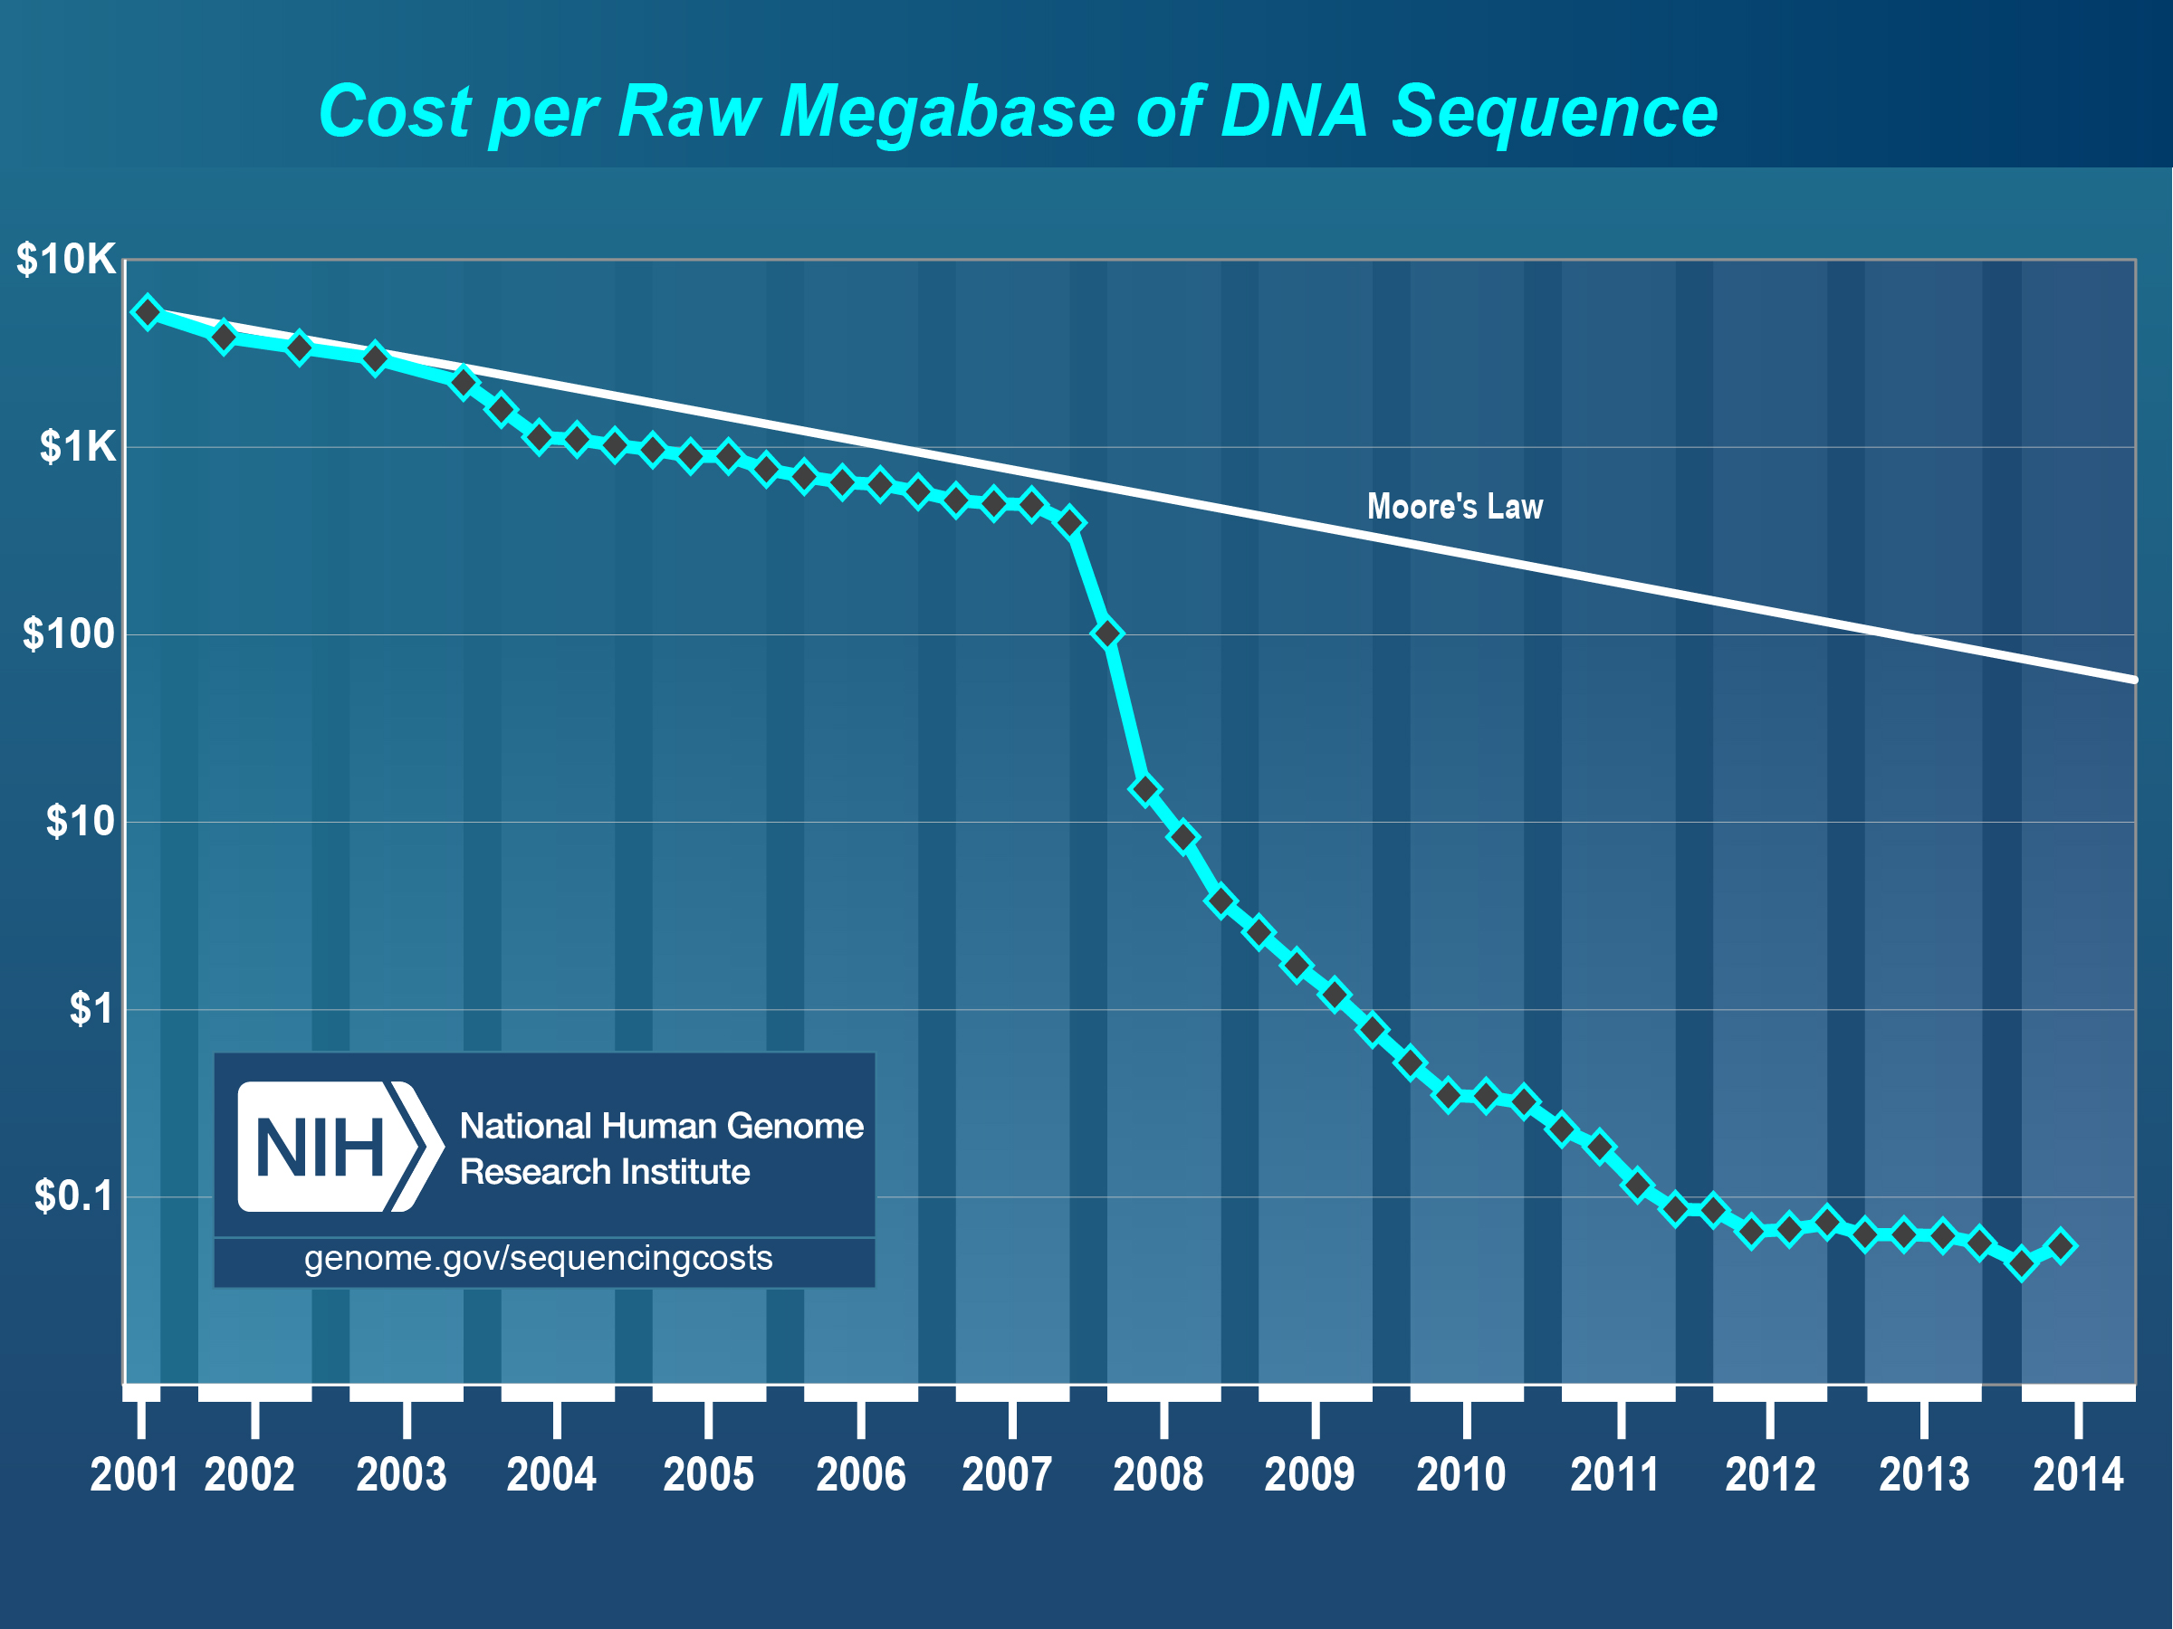
Genotyping-by-sequencing
Utilizes Next Generation Sequencing
Reduced representation
Barcoded samples for multiplex parallel sequencing
From Late 2014

Slide 3
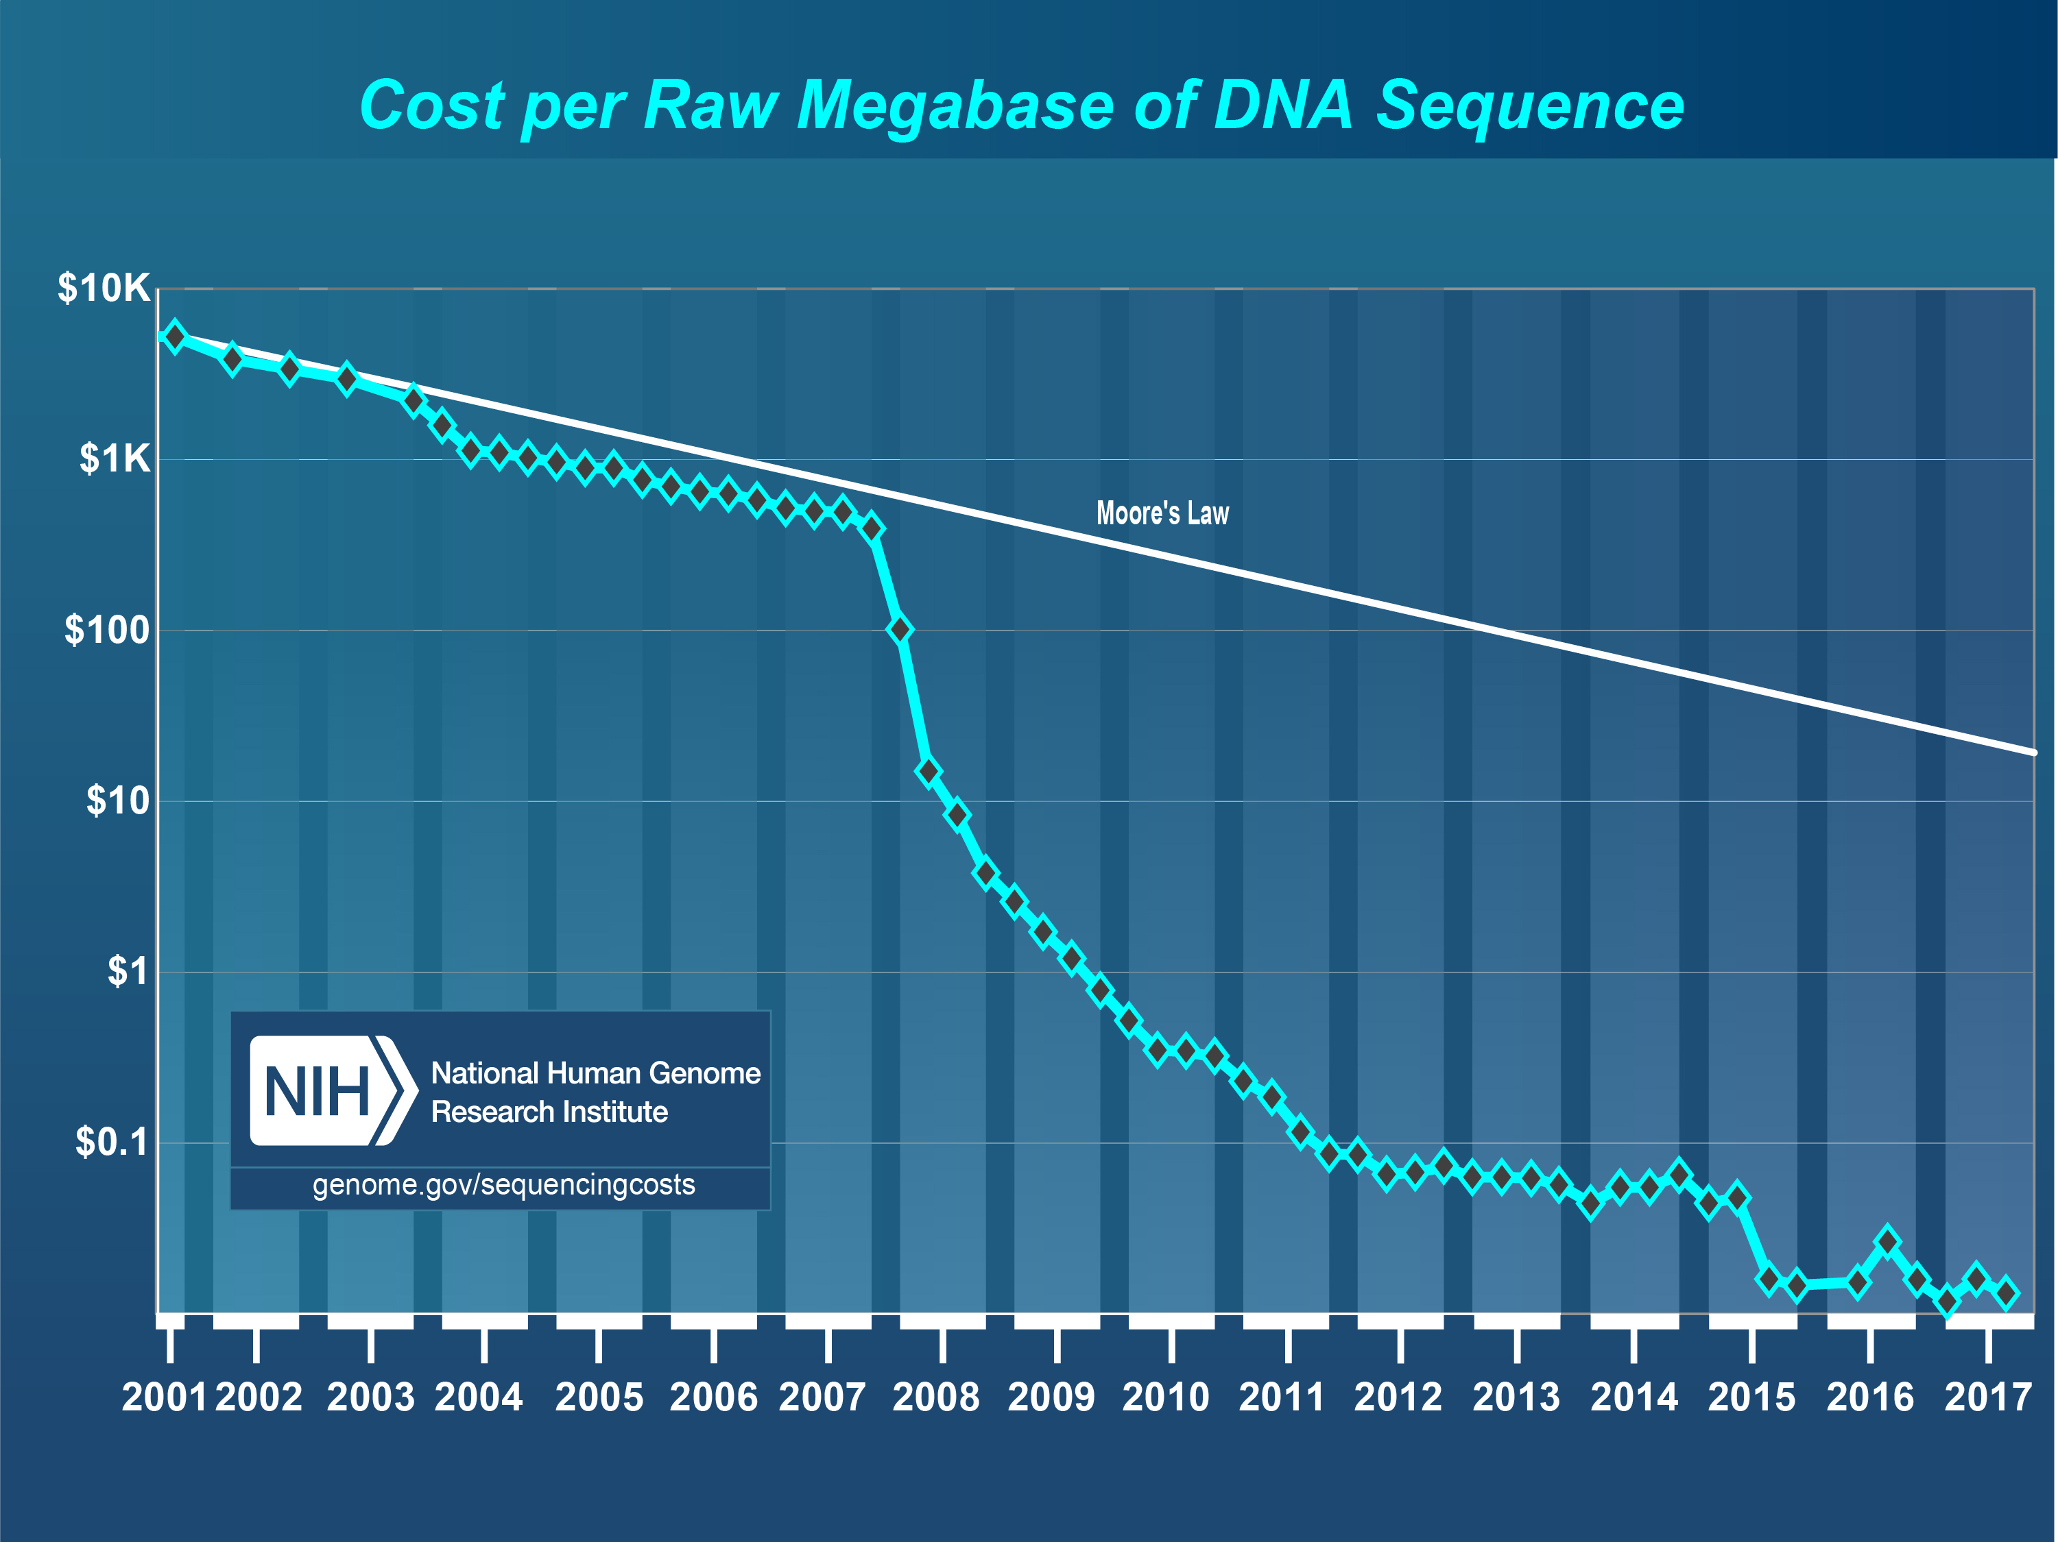

Slide 4
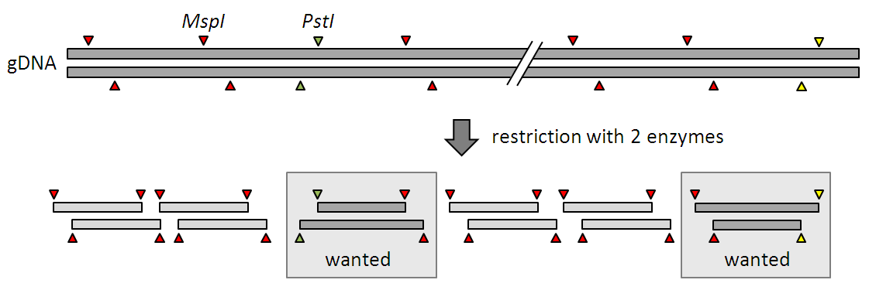
Reduced Representation
Cut the genome with restriction enzymes
Rare cutting PstI (CTGCAG)
Common cutting MspI (CCGG)
http://www.slideshare.net/LifeTechnologies/gbs-barley-ion-pgm-case-story-life-technologies-2012-rev-b-with-speaker-notes-may-2012

Slide 5
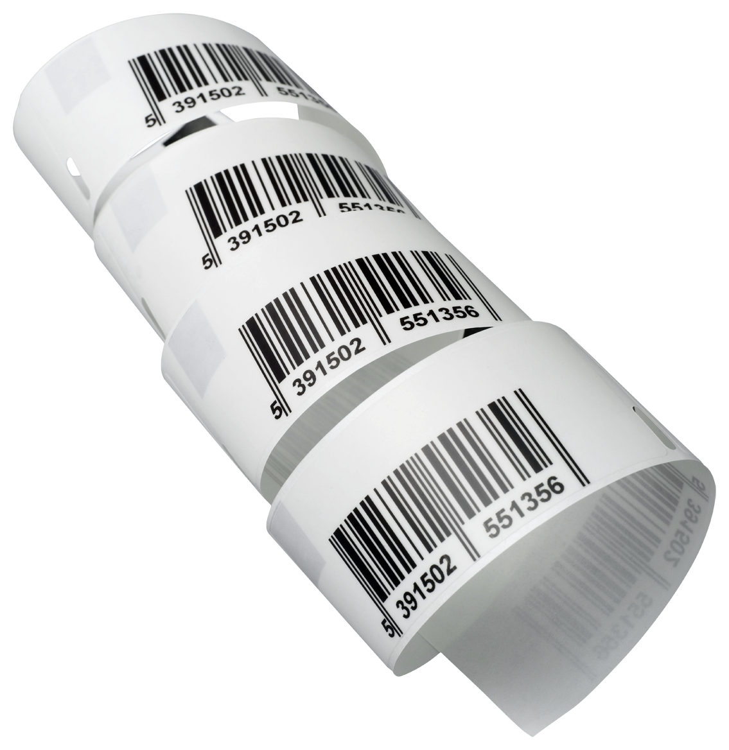

Barcoding
4-9 bp unique for each sample
Allows multiple samples to
be genotyped simultaneously

Slide 6
GBS workflow
(Poland and Rife, 2012)

Slide 7
Next Generation Sequencing
https://www.youtube.com/watch?annotation_id=annotation_1533942809&feature=iv&src_vid=HMyCqWhwB8E&v=fCd6B5HRaZ8
https://www.youtube.com/watch?v=9YxExTSwgPM

Slide 8
SNP discovery
Single nucleotide polymorphism (SNP)
GACTTAGACTTGGCTCT Plant 1
GACTTAGACTTGGCTCT Plant 2
GACTTAGACTCGGCTCT Plant 3
Simultaneous marker discovery and genotyping

Slide 9
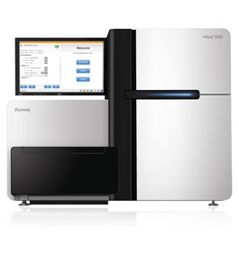
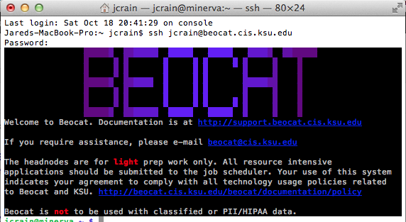

GBS Output
➔
826,269,115 total reads
systems.illumina.com
⬇
2,000-6,000 SNPs per population
⬅
692,636,061 accepted reads
32,166 SNPs

Slide 10
Sequencing to SNP Discovery/Calling
Several software will do this
Trait Analysis by Association Evolution and Linkage TASSEL

